Slide 1
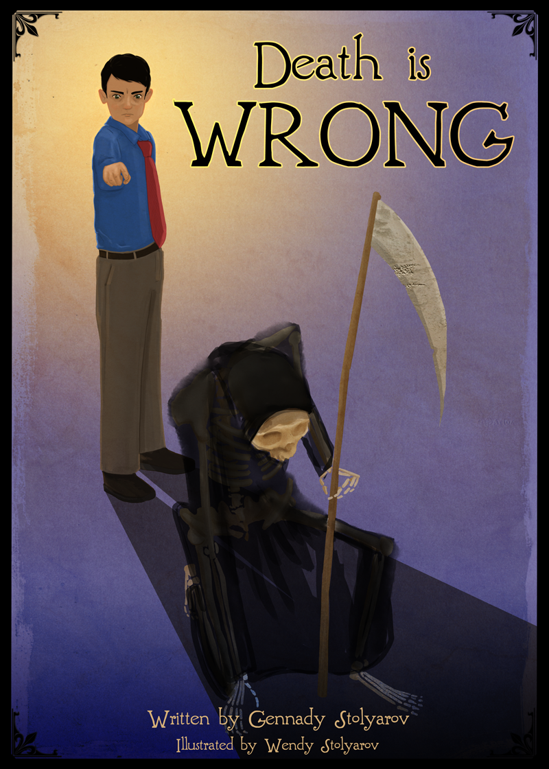
Why We Wrote a Children’s Book on Indefinite Life Extension
Gennady Stolyarov II and Wendy Stolyarov
Transhuman Visions 2.0
March 1, 2014

Slide 2
Imagine 2045: What Should We Fear?
Existential Risk? Technology run amok? NO!
We should fear a typical day in 2045 being much like a typical day in 2013, except farther along on the trajectory of decay.
“What happened to that Singularity we were promised?”
Will we at 58 be seen as quixotic dreamers about a future that never was? Will “kids these days” simply not care about life extension?
Will Luddism and change-aversion prevail?
Photograph by Tim Boyd,
Used pursuant to Creative Commons 2.0 Attribution Generic License

Slide 3
What We Could Do
At age 5, Gennady promised that he would devote his life to the struggle against death.
What can someone who is neither a doctor nor a biologist do?
He can use ideas in an effort to change the world - especially if he happens to be married to the best illustrator he knows.

Slide 4
Filling a Void
Everyone learns about death as a child, and everyone is viscerally appalled.
But there has been no antidote to the common excuses, evasions, and rationalizations that come shortly thereafter!
Now children have a resource to understand that the initial outrage at death is justified.

Slide 5
What Death is Wrong Offers
A bit of autobiography: How I found out about death as a child and realized that death is wrong
Examples and illustrations of long-lived creatures
Child-friendly summaries of key scientific breakthroughs and the SENS program
Philosophical arguments for life extension and rebuttals of common objections
What you could do with an indefinite lifespan
Quotations from five great pro-longevity thinkers: Francis Bacon to Alan Harrington

Slide 6
We Need a New Abolitionism!
"Urge immediate abolition as earnestly as we may, it will, alas! be gradual abolition in the end. We have never said that slavery would be overthrown by a single blow; that it ought to be, we shall always contend."
~ William Lloyd Garrison
Truer words were never spoken when it comes to the abolition of the death of innocent humans.

Slide 7
A New Generation of Activists
Even a handful of precocious children, committed to improving the prospects of indefinite life extension from an early age, could make the difference between us surviving indefinitely and being part of the last generations to die.
Spread the word to libraries, schools, bookstores, children’s activity groups – and any other place you can find these young potential cosmic revolutionaries!

Slide 8
How to Obtain It
Paperback version: Amazon and Createspace – or at this very conference!
Kindle version: $0.99 on Amazon
REVIEWS
“This is the book I wish I'd have read as a young child. ” ~ B.J. Murphy, The Proactionary Transhumanist
“This book is well-written, well-illustrated, and a fantastic read.” ~ Zoltan Istvan
“I recommend this one without reservation. It's worth reading.” ~ Prof. Charles N. Steele

Slide 9
Indiegogo Fundraiser
Title: “Help Teach 1000 Kids That Death is Wrong”
Project in Coordination with MILE: Movement for Indefinite Life Extension
Goal to raise $5000 to distribute 1000 copies of Death is Wrong to children, free of cost to them.
We can order copies from Createspace at the author’s discounted price, and ship copies to longevity activists throughout the US, for distribution to children in their local areas.
Flexible funding campaign: All donated funds will be used, no matter how much is given.
Deadline of April 23, 2014: Contribute today!

